Slide 1

Predicting Coupon Acceptance on
E-commerce Platforms

Slide 2
Predicting Coupon Acceptance on E-commerce Platforms
Objective:
The goal of this project is to predict whether a customer will accept a coupon based on factors like
demographics, time, and behavior.
Problem Statement:
Businesses use coupons to attract customers, but not everyone redeems them.
Understanding which customers are likely to accept a coupon can help
businesses target the right audience, improving marketing efficiency.
Outcome: We explored the dataset, cleaned and prepared the data, and tested different machine learning models.
After evaluation, we identified the best model for predicting coupon acceptance.
This can help businesses make better marketing decisions and increase customer engagement.

Slide 3


Data Overview
1
Dataset Size
12,684 rows and 25 columns.
2
Key Features
Coupon, Occupation, Income, Age, Bar, Passenger
3
Target Variable
Accept(Y/N)?

Slide 4
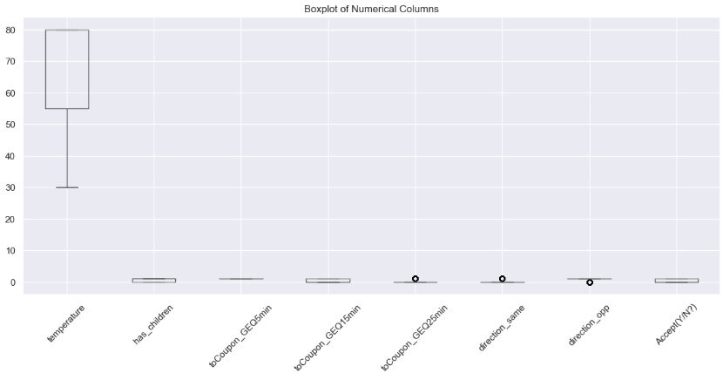
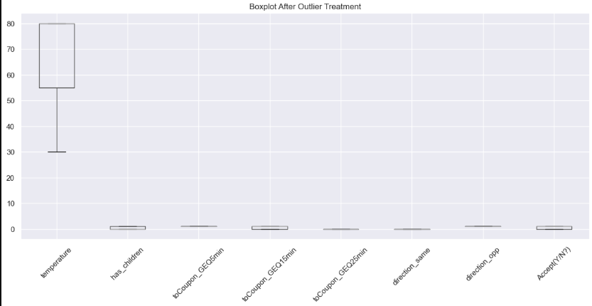
Data Preprocessing
1
Handling Missing Values
Used median imputation for numerical variables and (Mode) most frequent for categorical.
2
Outlier Treatment
Applied IQR based capping to reduce impact of extreme values.
3
Feature Scaling
Standardized numerical features using StandardScaler to ensure consistent scale across variables.

Slide 5
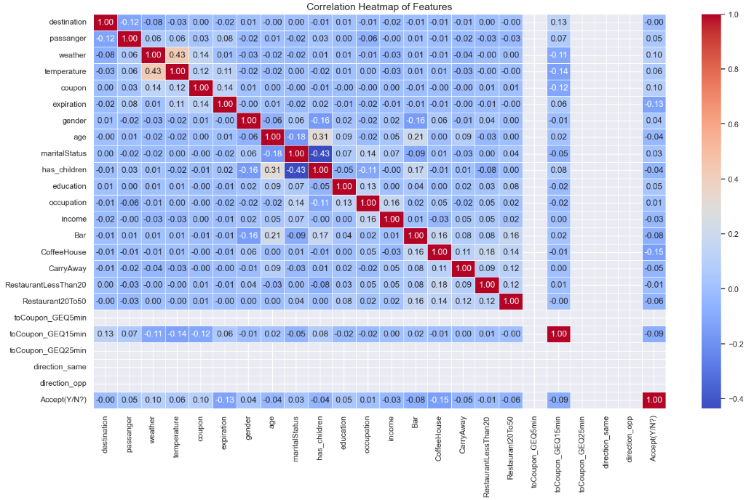
Exploratory Data Analysis
Correlation Analysis
Heatmap revealed relationships
between variables,
guiding feature selection.
What it Shows: Correlation between features (how they relate to each other). Red (Close to 1): Strong positive correlation (e.g., age & having children). Blue (Close to -1): Strong negative correlation. Near 0: No correlation (most features are independent).

Slide 6
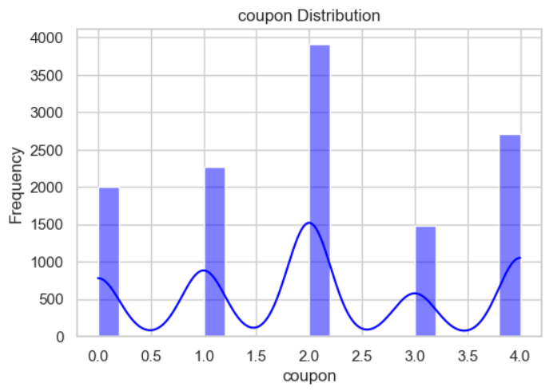
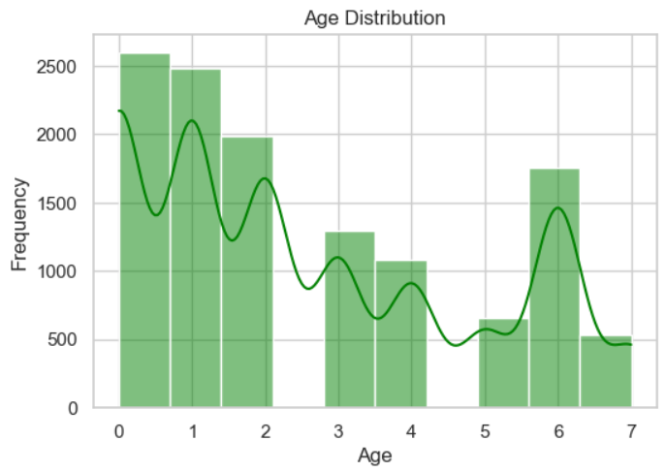
Exploratory Data Analysis
Distribution Plots
X-axis (coupon): Different coupon categories (0, 1, 2, 3, 4).
Y-axis (Frequency): How often each coupon type appears.
Highest Frequency: Coupon 2 has the most occurrences (~4000).
Other Peaks: Coupons 1, 4, and 0 also appear frequently.
Lowest Frequency: Coupon 3 is the least common.
Blue Line (KDE Curve): Shows the smooth trend of distribution.
X-axis (Age): Different age groups (0 to 7).
Y-axis (Frequency): Number of people in each age group.
Most Common Ages: Categories 0 and 1 have the highest count (~2500+).
Other Peaks: Age groups 2, 3, and 6 also have notable frequencies.
Least Common Ages: Groups 5 and 7 have the lowest count.
Green Line (KDE Curve): Shows the trend of age distribution.

Slide 7
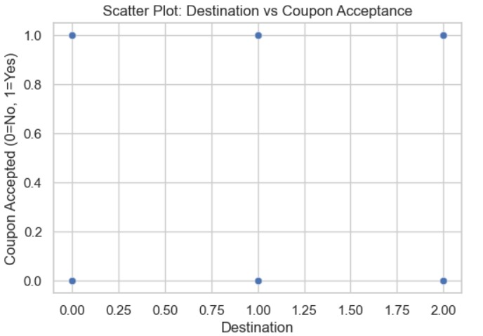
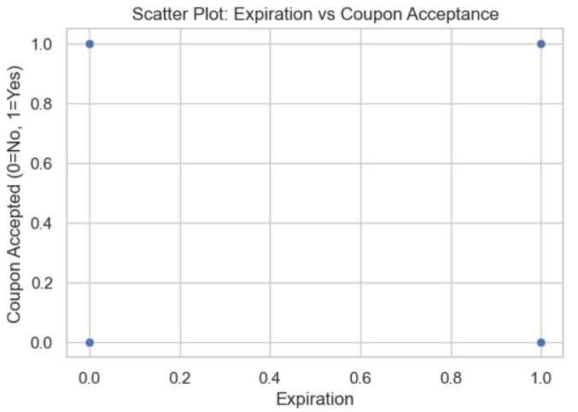
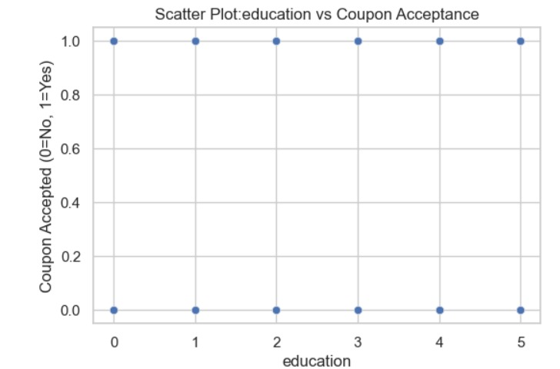
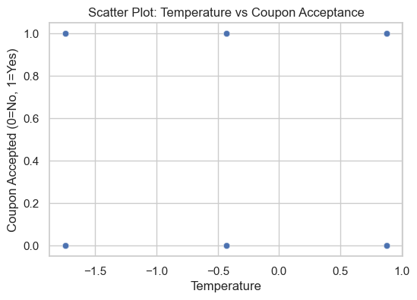
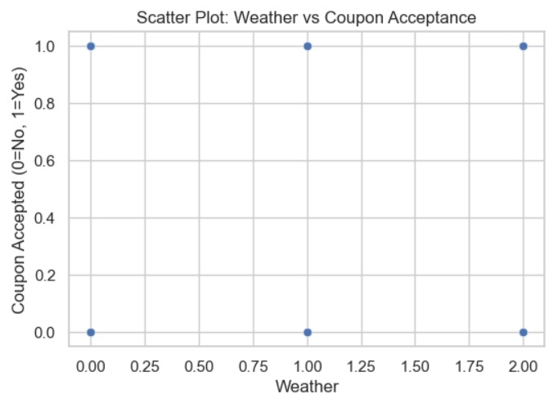
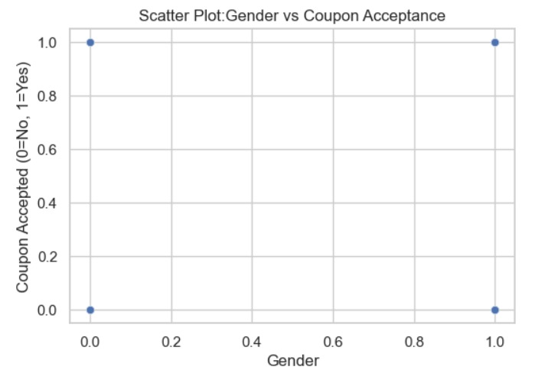
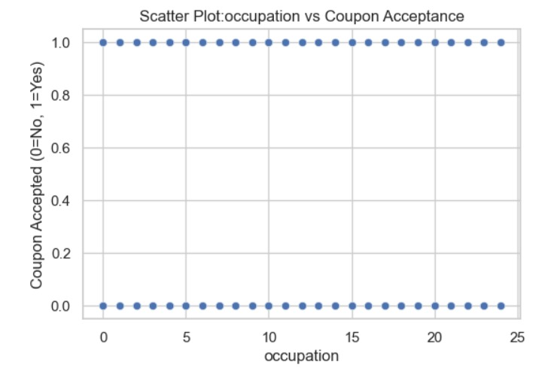
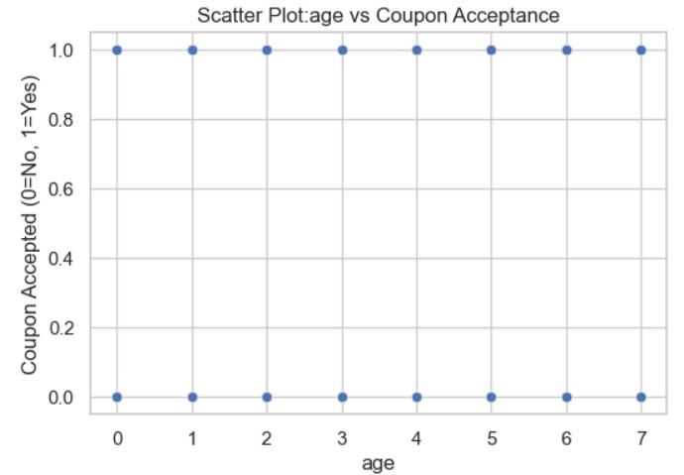
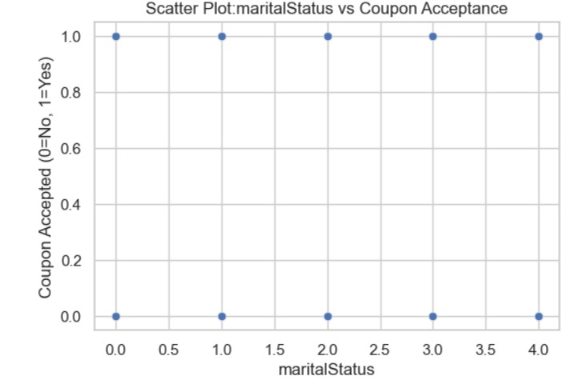
Scatter Plots
The scatter plots examine the relationship between features (e.g., temperature, destination, gender) and coupon acceptance.
No clear trends or strong correlations are observed in any plot.
Individual features like weather, expiration, or education have minimal impact on coupon acceptance.
Advanced analysis, such as combining features or using machine learning, is needed to identify meaningful patterns.

Slide 8
Model Selection
Classification Models
Spliting Data
Optimization
Logistic Regression, Random Forest, XGBoost, Gradient Boosting AdaBoost, Ridge Classifier, Perceptron, SVC, LinearSVC, K-Neighbors, Gaussian Naive Bayes, Bernoulli Naive Bayes, Decision Tree
Divides the dataset into two parts:
Training set → Used to train the model.
Test set → Used to evaluate the model.
Cross-Validation (CV)
Divides data into multiple parts (folds) and trains the model multiple times.
Each fold acts as a test set once and as a training set the rest of the time.
XGBoost enhances accuracy with boosting, handling missing values, and feature importance. Cross-validation (CV) ensures stability by averaging scores across K-folds, preventing overfitting and optimizing hyperparameters.

Slide 9
Model Training and Evaluation
Data Splitting
Performance Metrics
80% training, 20% testing split for model evaluation.
Compare models using accuracy, precision, recall, F1-score, and AUC-ROC.
1
2
3
Cross Validation on all models
Multiple models are tested using 10-fold cross-validation.
Each model is trained & tested 10 times on different data splits.
Mean accuracy is calculated for fair com

Slide 10
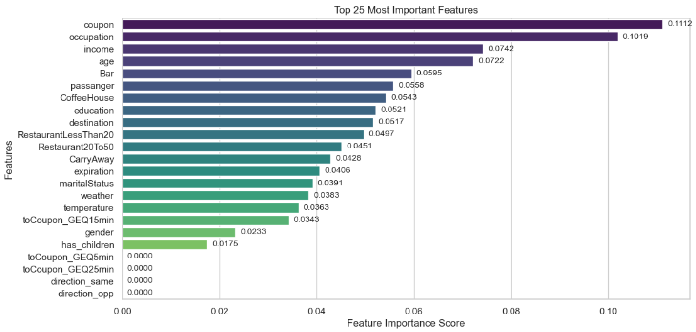



Feature Importance
Coupon
Most important feature with importance 11%.
Occupation
Second most important at 10%.
Income
Third most important contribute 7%.

Slide 11
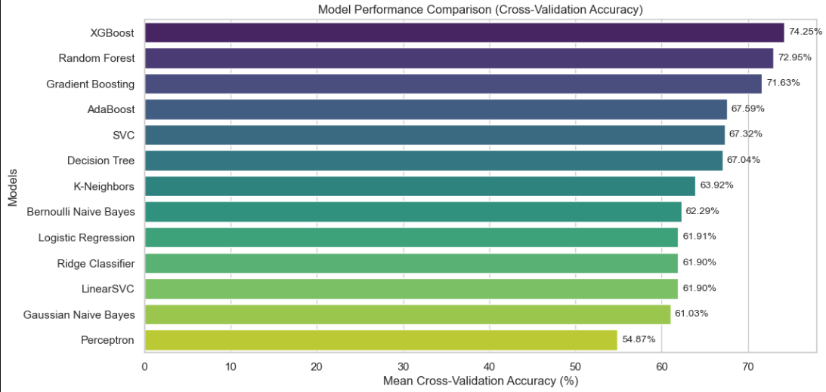
Model Performance Comparison
Best Performer
Runner-up
Baseline
XG Boost achieved highest Model Accuracy of 74.25%.
Random Forest achieved second highest model accuracy of 72.95%
The lowest-performing model is Perceptron (54.87%), which can be considered as the baseline.

Slide 12

Key Findings
1
Best Model
XG Boost outperformed over other models in predicting coupon acceptance.
2
Important Factors
Occupation and Coupon significantly influence Coupon acceptance on E-commerce.
3
Model Accuracy
Achieved 74.25% accuracy in predicting Coupon acceptance.

Slide 13
THANK YOU
Coupon Acceptance Prediction by Prateek Tripathi

